Slide 1
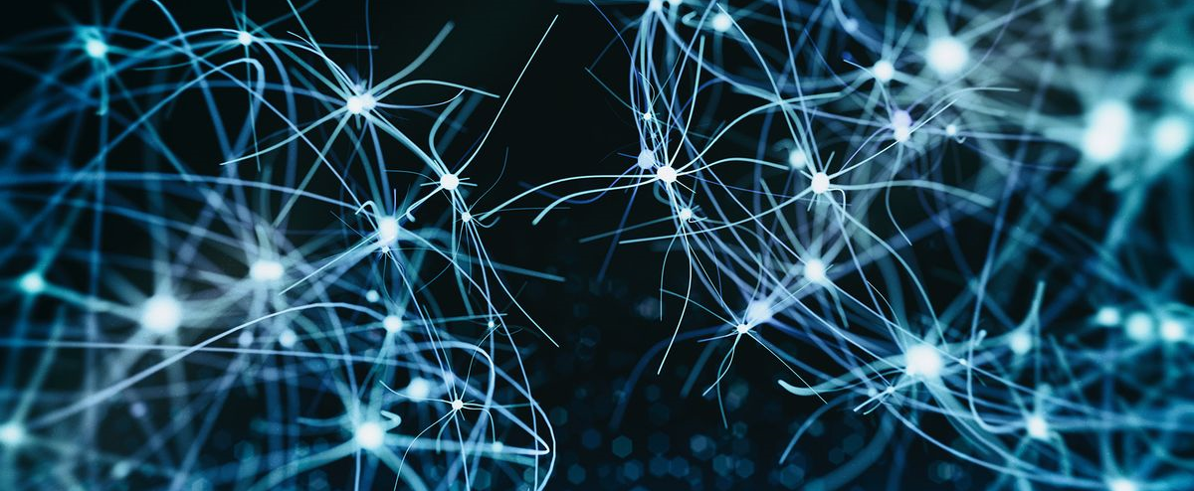

BMB3015 ARTIFICIAL INTELLIGENCE
UNCERTAINTY & BAYES’ RULE

Slide 2
Uncertainty
Let action A_{t} = leave for airport t minutes before flight.
Will A_{t} get me there on time?
Problems:
partial observability (road state, other drivers' plans, etc.)
noisy sensors (traffic reports) uncertainty in action outcomes (flat tire, etc.) immense complexity of modeling and predicting traffic
Hence a purely logical approach either
risks falsehood:
A₂₅ → will get me there on time
leads to conclusions that are too weak for decision making:
A₂₅ → will get me there on time if there's no accident on the bridge and it doesn't rain and my tires remain intact etc.
A₁₄₄₀ → might reasonably be said to get me there on time but I'd have to stay overnight in the airport

Slide 3
Methods for Handling Uncertainty
Default or nonmonotonic logic:
Assume my car does not have a flat tire
Assume A₂₅ works unless contradicted by evidence
Issues:
What assumptions are reasonable?
How to handle contradiction?
Rules with fudge factors:
A₂₅ |→_{0.3} get there on time
Sprinkler |→ _{0.99} WetGrass
WetGrass |→ _{0.7} Rain
Issues: Problems with combination, e.g., Sprinkler causes Rain??
Notes:
Fudge factor→ Belirsizlik telafi faktörü
Entail→ gerektirmek

Slide 4
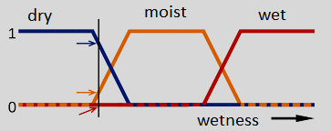
Methods for Handling Uncertainty
Fuzzy logic
useful when decisions are not certainly true or false
in fact handles degree of truth NOT uncertainty
e.g., MoistGrass is true to degree 0.2
Probability
Models agent's degree of belief given the available evidence
A₂₅ will get me there on time with probability 0.04
Notes:
Fudge factor→ Belirsizlik telafi faktörü
Entail→ gerektirmek

Slide 5
Probability
Probabilistic assertions summarize effects of
laziness: failure to enumerate exceptions, qualifications, etc.
ignorance: lack of relevant facts, initial conditions, etc.
Subjective or Bayesian probability:
Probabilities relate propositions to agent's own state of knowledge:
e.g., P(A₂₅ gets me there on time | no reported accidents) = 0.06
These are not claims of a «probabilistic tendency» in the current situation, but might be learned from past experience of similar situations.
Probabilities of propositions change with new evidence:
e.g., P(A₂₅ gets me there on time | no reported accidents, 5 a.m.) = 0.15
Notes:
Analogous to logical entailment status KB |→ $α$ , but not truth.
Laziness tembellik
Ignorance bilgisizlik

Slide 6
Making Decisions under Uncertainty
Suppose I believe the following:
P(A₂₅ gets me there on time | …) = 0.04
P(A₉₀ gets me there on time | …) = 0.70
P(A₁₂₀ gets me there on time | …)= 0.95
P(A₁₄₄₀ gets me there on time | …)= 0.9999
Which action to choose?
Depends on my preferences for missing flight vs. time spent waiting, etc.
Utility theory is used to represent and infer preferences
Decision theory = probability theory + utility theory

Slide 7
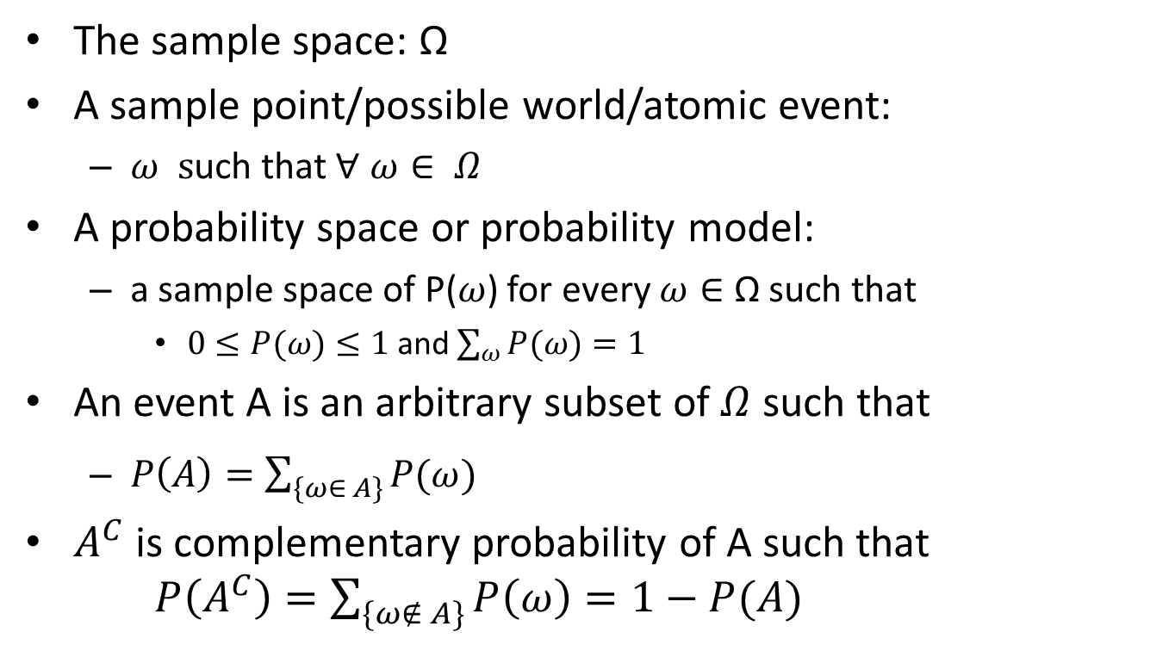
Probability Basics
The sample space: Ω
A sample point/possible world/atomic event:
$ω s$uch that $∀ ω∈ Ω$
A probability space or probability model:
a sample space of P($ω$) for every $ω∈$ Ω such that
$0≤P(ω)≤1$ and $\sum_{ω}{P(ω)}=1$
An event A is an arbitrary subset of $Ω$ such that
$P\left(A\right)=\sum_{\{ω∈ A\}}{P(ω)}$
$A^{C}$ is complementary probability of A such that $P\left(A^{C}\right)=\sum_{\{ω∉ A\}}{P\left(ω\right)=1−P(A)}$

Slide 8
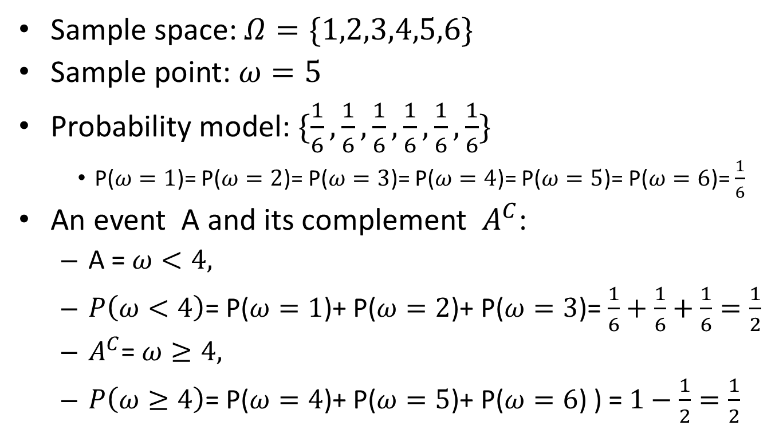
A Simple Example: Rolling a Dice
Sample space: $Ω=\{1,2,3,4,5,6\}$
Sample point: $ω=5$
Probability model: $\{\frac{1}{6},\frac{1}{6},\frac{1}{6},\frac{1}{6},\frac{1}{6},\frac{1}{6}\}$
P($ω=1$)= P($ω=2$)= P($ω=3$)= P($ω=4$)= P($ω=5$)= P($ω=6$)= $\frac{1}{6}$
An event A and its complement $A^{C}$:
A = $ω<4,$
$P\left(ω<4\right)$= P($ω=1$)+ P($ω=2$)+ P($ω=3$)=$\frac{1}{6}+\frac{1}{6}+\frac{1}{6}=\frac{1}{2}$
$A^{C}$= $ω≥4,$
$P\left(ω≥4\right)$= P($ω=4$)+ P($ω=5$)+ P($ω=6$) ) =$1−\frac{1}{2}=\frac{1}{2}$

Slide 9
Atomic Events (Sample Points)
A complete specification of the state of the world about which the agent is uncertain
Atomic events are mutually exclusive and exhaustive
Often in AI applications, atomic events are defined by assignment of values to random variables
i.e., the sample space is the Cartesian product of the ranges of the variables
similar to propositional logic

Slide 10
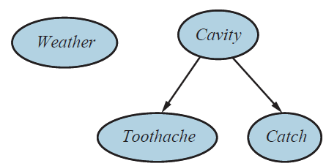
Example: Cavity
Random variables
Weather, Cavity, Toothache, Catch
Notes:
Catch→ diş doktorunun diş kontrol çubuğunun dişe takılması
Toothache→ diş ağrısı
Cavity→çürük

Slide 11
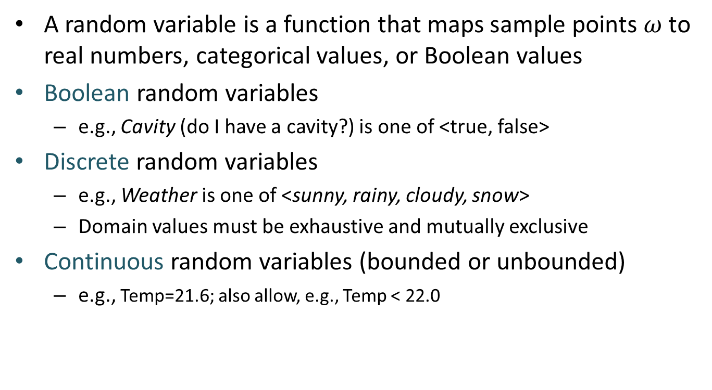
Random Variables
A random variable is a function that maps sample points $ω$ to real numbers, categorical values, or Boolean values
Boolean random variables
e.g., Cavity (do I have a cavity?) is one of <true, false>
Discrete random variables
e.g., Weather is one of <sunny, rainy, cloudy, snow>
Domain values must be exhaustive and mutually exclusive
Continuous random variables (bounded or unbounded)
e.g., Temp=21.6; also allow, e.g., Temp < 22.0

Slide 12
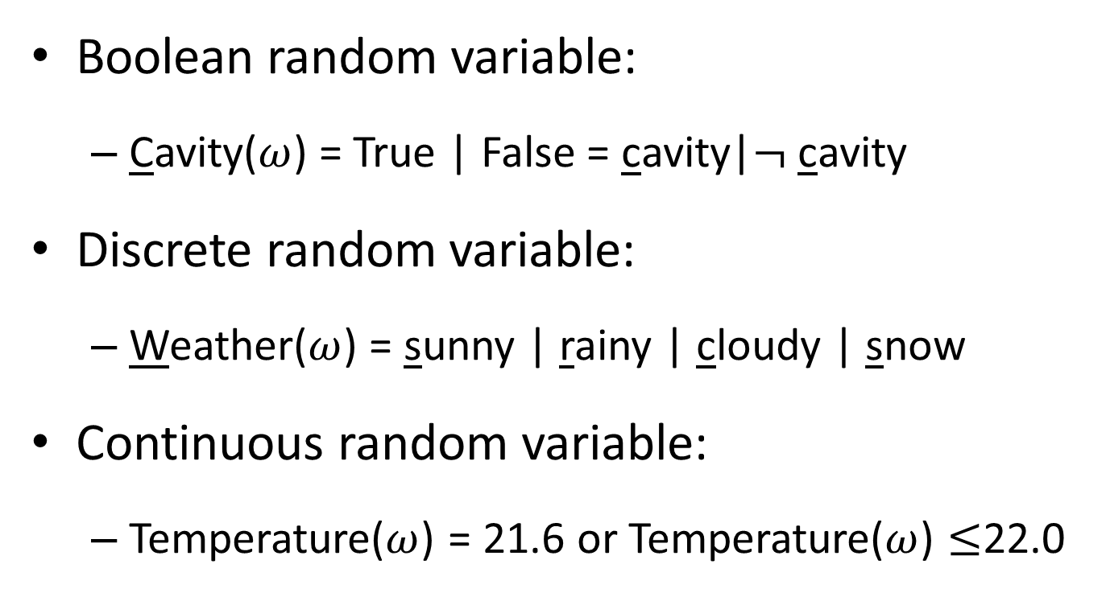
Random Variables: Notation
Boolean random variable:
Cavity($ω$) = True | False = cavity|$¬$ cavity
Discrete random variable:
Weather($ω$) = sunny | rainy | cloudy | snow
Continuous random variable:
Temperature($ω$) = 21.6 or Temperature($ω$) $≤$22.0

Slide 13
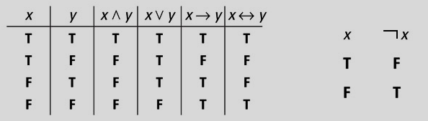

Logical Operators
ꓦ: or
ꓥ: and
$¬$: not
$→$: if
$↔$: if and only if (iff)

Slide 14
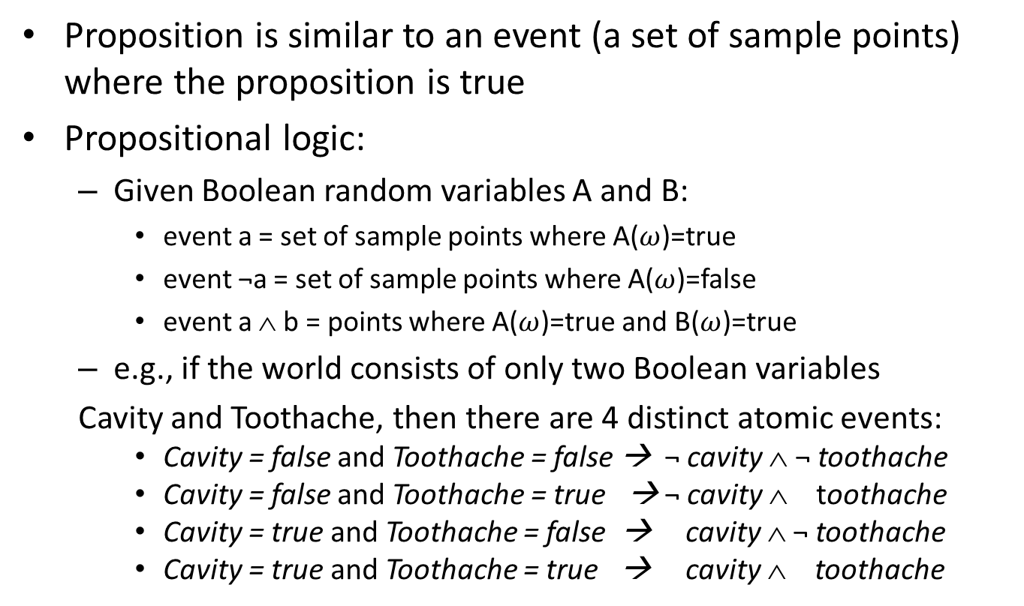
Propositions
Proposition is similar to an event (a set of sample points) where the proposition is true
Propositional logic:
Given Boolean random variables A and B:
event a = set of sample points where A($ω$)=true
event ¬a = set of sample points where A($ω$)=false
event a ∧ b = points where A($ω$)=true and B($ω$)=true
e.g., if the world consists of only two Boolean variables
Cavity and Toothache, then there are 4 distinct atomic events:
Cavity = false and Toothache = false → ¬ cavity ∧ ¬ toothache
Cavity = false and Toothache = true → ¬ cavity ∧ toothache
Cavity = true and Toothache = false → cavity ∧ ¬ toothache
Cavity = true and Toothache = true → cavity ∧ toothache

Slide 15
Propositions
Elementary proposition constructed by assignment of a value to a random variable:
Weather = sunny
Cavity = false (abbreviated as ¬cavity)
Complex propositions formed from elementary propositions and standard logical connectives
Weather = sunny ∨ Cavity = false

Slide 16
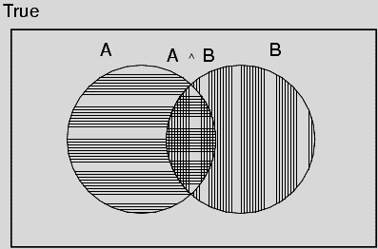
Axioms of Probability
The definitions imply that certain logically related events must have related probabilities.
For any propositions A, B
0 ≤ P(A) ≤ 1
P(true) = 1 and P(false) = 0
P(A ∨ B) = P(A) + P(B) - P(A ∧ B)
Notes:
Axiom: A thought or judgement commonly accepted to be true

Slide 17
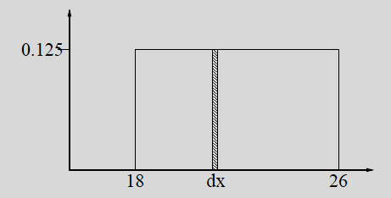
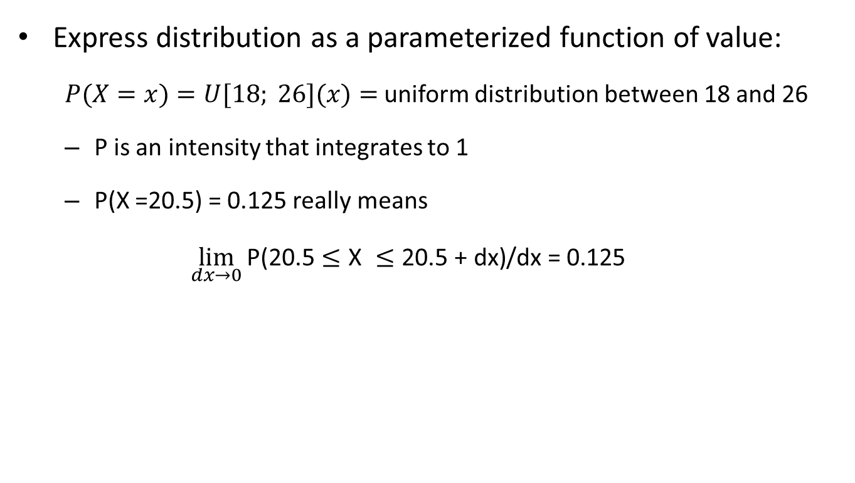
Probability for Continuous Variables
Express distribution as a parameterized function of value:
$P(X=x)=U[18; 26](x)=$uniform distribution between 18 and 26
P is an intensity that integrates to 1
P(X =20.5) = 0.125 really means
$$\lim_{dx→0}{\text{P}\text{(20.5}≤\text{X} ≤\text{20}\text{.}\text{5 + }\text{dx}\text{)/}\text{dx}\text{ = 0.125}}$$

Slide 18
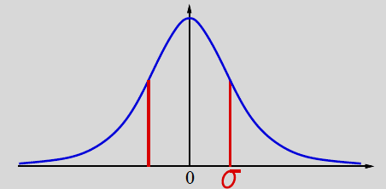
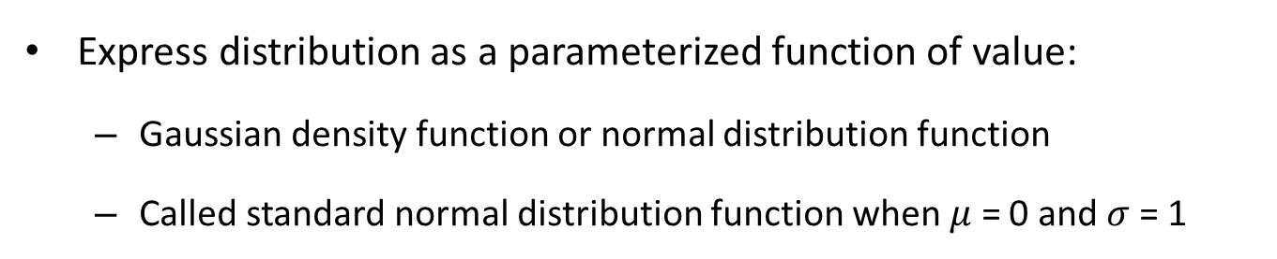

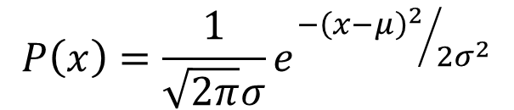
Probability for Continuous Variables
Express distribution as a parameterized function of value:
Gaussian density function or normal distribution function
Called standard normal distribution function when $μ$ = 0 and $σ$= 1
$$P\left(x\right)=\frac{1}{\sqrt{2π}σ}e^{{−{\left(x−μ\right)}^{2}}/{2σ^{2}}}$$
Normal distribution function
$$μ$$

Slide 19
Prior Probability
Prior or unconditional probabilities of propositions
corresponds to belief prior to arrival of any (new) evidence
e.g., P(Cavity = true) = 0.1 and P(Weather = sunny) = 0.72
Probability distribution gives values for all possible assignments:
P(Weather) = <0.72, 0.1, 0.08, 0.1> (normalized, i.e., sums to 1)

Slide 20
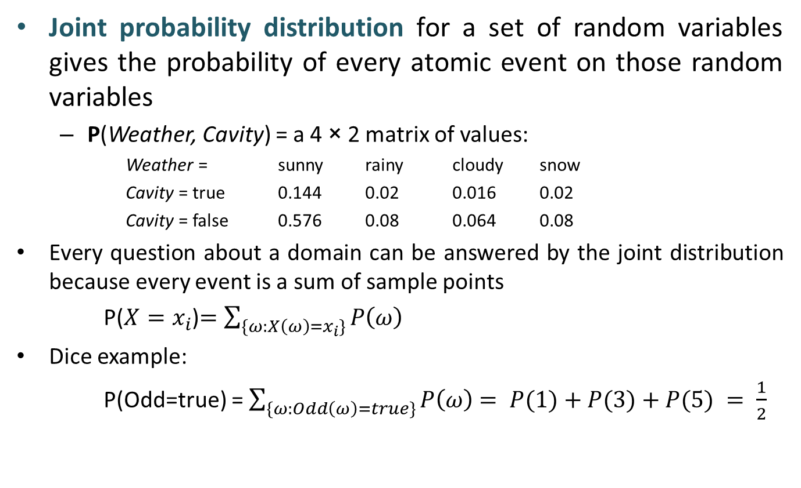
Joint Probability Distribution
Joint probability distribution for a set of random variables gives the probability of every atomic event on those random variables
P(Weather, Cavity) = a 4 × 2 matrix of values:
Weather = sunny rainy cloudy snow
Cavity = true 0.144 0.02 0.016 0.02
Cavity = false 0.576 0.08 0.064 0.08
Every question about a domain can be answered by the joint distribution because every event is a sum of sample points
P($X=x_{i}$)$=\sum_{\{ω:X\left(ω\right)=x_{i}\}}{P\left(ω\right)}$
Dice example:
P(Odd=true) = $\sum_{\{ω:Odd\left(ω\right)=true\}}{P\left(ω\right)}$ $= P(1)+P(3)+P(5) = \frac{1}{2}$
Notes:
P(Whether=sunny) = 0.144 + 0.576 = 0.72
P(Cavity=true) = 0.144+0.02+0.016+0.02 = 0.2
P(Whether=sunny, Cavity=true) = 0.72 * 0.2 = 0.144

Slide 21
Conditional Probability
Conditional or posterior probabilities
e.g., P(cavity | toothache) = 0.8
i.e., given that toothache is all I know
Notation for conditional distributions:
P(Cavity | Toothache) = 2-element vector of 2-element vectors
If we know more, e.g., cavity is also given, then we have
P(cavity | toothache, cavity) = 1
New evidence may be irrelevant, allowing simplification, e.g.,
P(cavity | toothache, sunny) = P(cavity | toothache) = 0.8
This kind of inference, sanctioned by domain knowledge, is crucial.
Notes:
sanctioned –>uygun görmek, onay vermek

Slide 22
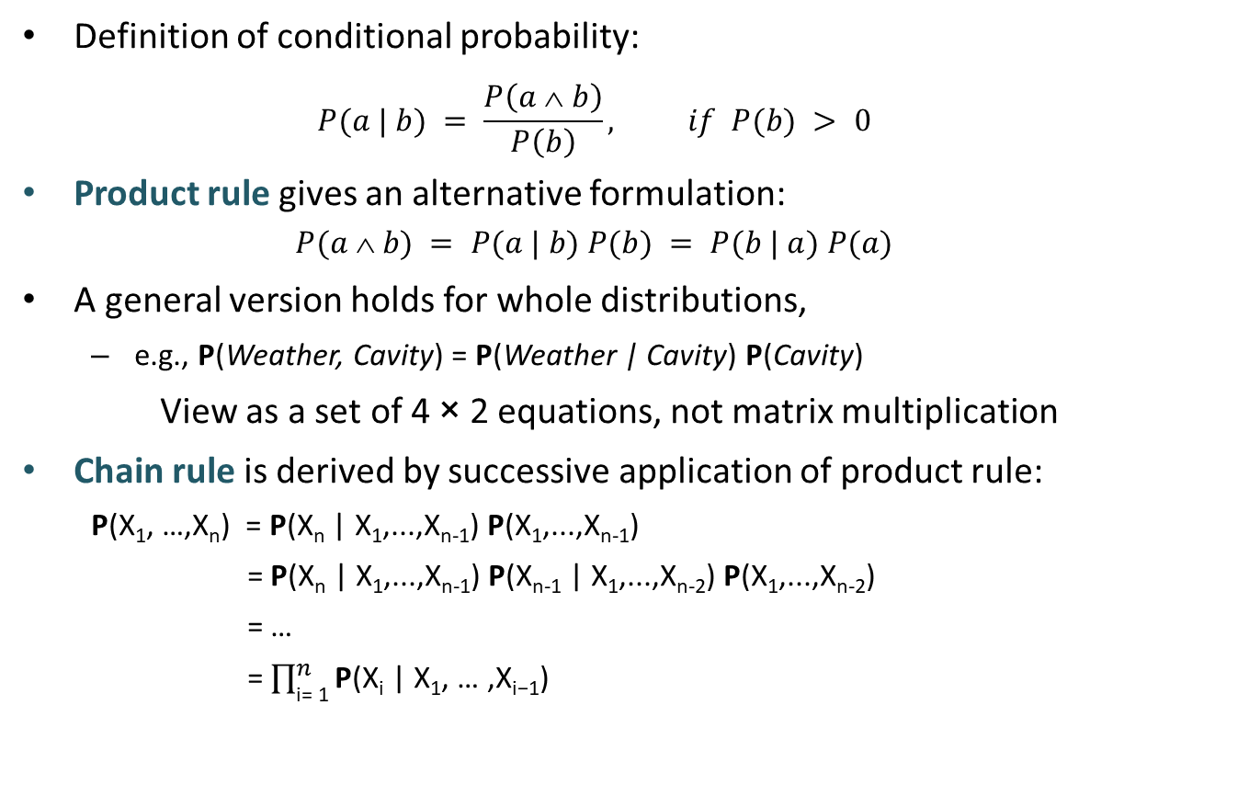
Conditional Probability
Definition of conditional probability:
$$P(a | b) = \frac{P\left(a \text{} b\right)}{P\left(b\right)}, if P(b) > 0$$
Product rule gives an alternative formulation:
$$P(a \text{} b) = P(a | b) P(b) = P(b | a) P(a)$$
A general version holds for whole distributions,
e.g., P(Weather, Cavity) = P(Weather | Cavity) P(Cavity)
View as a set of 4 × 2 equations, not matrix multiplication
Chain rule is derived by successive application of product rule:
P(X₁, …,X_{n}) = P(X_{n} | X₁,...,X_{n-1}) P(X₁,...,X_{n-1})
= P(X_{n} | X₁,...,X_{n-1}) P(X_{n-1} | X₁,...,X_{n-2}) P(X₁,...,X_{n-2})
= …
= $\prod_{\text{i}\text{= }\text{1}}^{n}{\text{P}\text{(}\text{X}\text{i}\text{ | }\text{X}\text{1}\text{, … ,}\text{X}\text{i}\text{−1}\text{) }}$

Slide 23
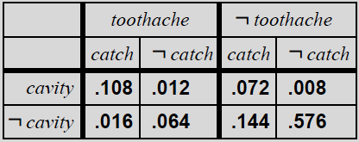
Inference by Enumeration
Start with the joint probability distribution:
For any proposition φ, sum the atomic events where it is true: P(φ) = Σ_{ω:ω╞φ} P(ω)
Notes:
Enumeration→Döküm, ayrıntılı liste

Slide 24
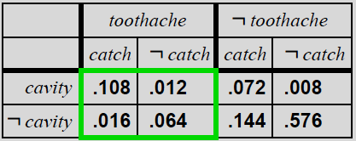
Inference by Enumeration
The joint probability distribution:
P(toothache) = 0.108 + 0.012 + 0.016 + 0.064 = 0.2

Slide 25
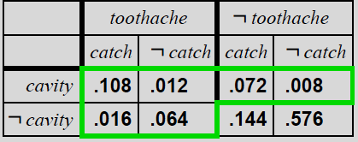

Inference by Enumeration
The joint probability distribution:
P(cavity $˅$ toothache) = 0.108+0.012+0.072+
0.008+0.016+0.064 = 0.28

Slide 26
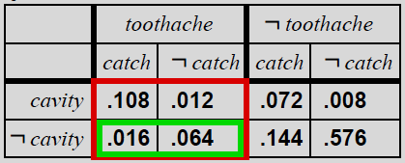
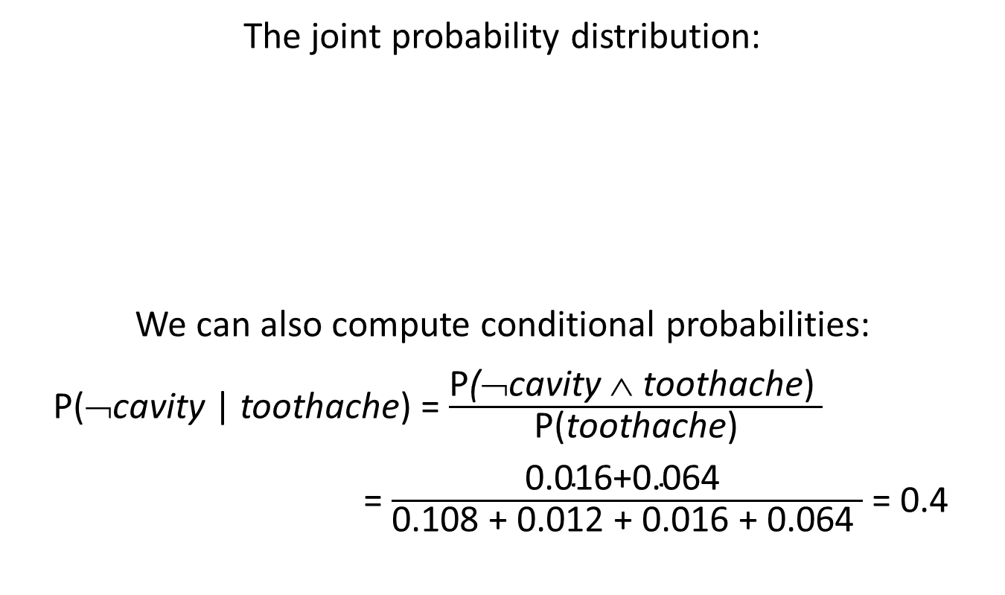
Inference by Enumeration
The joint probability distribution:
We can also compute conditional probabilities:
P(¬cavity | toothache) = $\frac{\text{P}\text{(}\text{¬}\text{cavity} \text{∧ }\text{toothache}\text{) }}{\text{P}\text{(}\text{toothache}\text{)}}$
= $\frac{\text{0.016+0.064 }}{\text{0.108 + 0.012 + 0.016 + 0.064 }}$ = 0.4

Slide 27
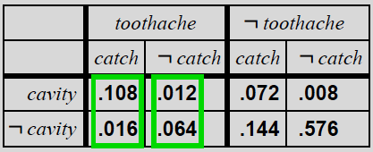
Normalization
Denominator can be viewed as a normalization constant α
P(Cavity | toothache) = α P(Cavity, toothache)
= α [P(Cavity, toothache, catch) + P(Cavity, toothache,¬ catch)]
= α [<0.108,0.016> + <0.012,0.064>]
= α <0.12,0.08> = <0.6,0.4>
α = 1/0.2
General idea: compute distribution on query variable by fixing evidence variables and summing over hidden variables

Slide 28
Inference by Enumeration
Typically, we are interested in
the posterior joint distribution of the query variables Y
given specific values e for the evidence variables E
Let the hidden variables be H = X – Y – E
Then the required summation of joint entries is done by summing out the hidden variables:
P(Y | E = e) = α P(Y, E = e) = α Σ_{h} P(Y, E= e, H = h)
The terms in the summation are joint entries because Y, E, and H together exhaust the set of random variables

Slide 29
Inference by Enumeration
n→ the number of random variables
d→ the number of values for a random variable
Obvious problems:
Worst-case time complexity O(d^{n}) where d is the largest arity
Space complexity O(d^{n}) to store the joint distribution
How to find the numbers for O(d^{n}) entries?
Notes:
Arity→ programlamada özel bir işlev için alınan parametrelerin sayısı

Slide 30
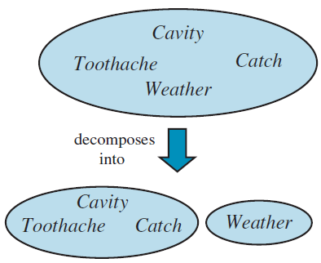
Independence
A and B are independent if and only if
P(A|B) = P(A) or P(B|A) = P(B) or P(A, B) = P(A) P(B)
P(Toothache, Catch, Cavity, Weather)
= P(Toothache, Catch, Cavity) P(Weather)
32 entries reduced to 12;
for n independent biased coins, O(2^{n}) →O(n)
Absolute independence is powerful but rare
Dentistry is a large field with hundreds of variables, none of which are independent. What to do?
Toothache = {true, false}
Catch= {true, false}
Cavity= {true, false}
Weather = {sunny, rainy,
cloudy, snow}

Slide 31
Conditional Independence
If I have a cavity, the probability that the probe catches in it doesn't depend on whether I have a toothache:
P(catch | toothache, cavity) = P(catch | cavity)
The same independence holds if I haven't got a cavity:
P(catch | toothache, ¬cavity) = P(catch | ¬cavity)
Catch is conditionally independent of Toothache given Cavity:
P(Catch | Toothache, Cavity) = P(Catch | Cavity)
Equivalent statements:
P(Toothache | Catch, Cavity) = P(Toothache | Cavity)
P(Toothache, Catch | Cavity) = P(Toothache | Cavity) P(Catch | Cavity)
Notes:
Given the presence or absence of a cavity; catch and toothache are independent.
Conceptually Cavity separates Toothache and Catch because it is a direct cause of both of them.
P(Toothache, Cavity, Catch) = P(Toothache, Catch | Cavity) P(Cavity) (Product rule)
= P(Toothache| Cavity) P(Catch | Cavity) P(Cavity) → Requires 2x(2¹ – 1) (for conditional prob.)+(2¹ – 1) (for prior prob.) entries

Slide 32
Example Revisited
Topology of network encodes conditional independence assertions
Weather is independent of the other variables
Toothache and Catch are conditionally independent given Cavity

Slide 33
Conditional Independence
Joint distribution P(Toothache, Cavity, Catch) requires
2³ – 1 = 7 entries
Write out full joint distribution using chain rule:
P(Toothache, Catch, Cavity)
= P(Toothache | Catch, Cavity) P(Catch, Cavity) = P(Toothache | Catch, Cavity) P(Catch | Cavity) P(Cavity) = P(Toothache | Cavity) P(Catch | Cavity) P(Cavity) requires 2 + 2 + 1 = 5 entries
In most cases, the use of conditional independence reduces the size of the representation of the joint distribution from O(2^{n}) to O(n).
Conditional independence is our most basic and robust form of knowledge about uncertain environments.

Slide 34
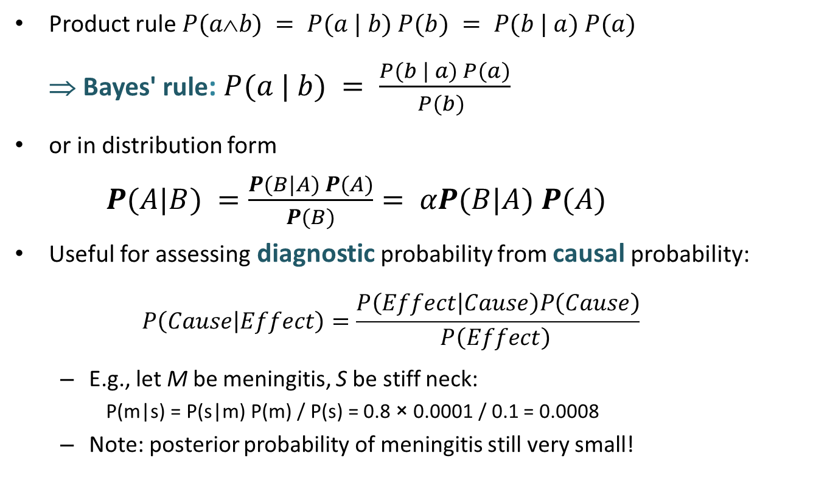
Bayes’ Rule
Product rule $P(ab) = P(a | b) P(b) = P(b | a) P(a)$
⇒ Bayes' rule: $P(a | b) = \frac{P(b | a) P(a)}{P(b) }$
or in distribution form
$P(A|B) =\frac{P(B|A) P(A)}{P(B)}= αP(B|A) P(A)$
Useful for assessing diagnostic probability from causal probability:
$$P\left(Cause | Effect\right)=\frac{P\left(Effect | Cause\right)P\left(Cause\right)}{P\left(Effect\right) }$$
E.g., let M be meningitis, S be stiff neck:
P(m|s) = P(s|m) P(m) / P(s) = 0.8 × 0.0001 / 0.1 = 0.0008
Note: posterior probability of meningitis still very small!

Slide 35
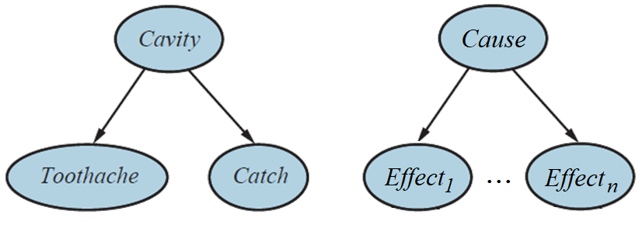
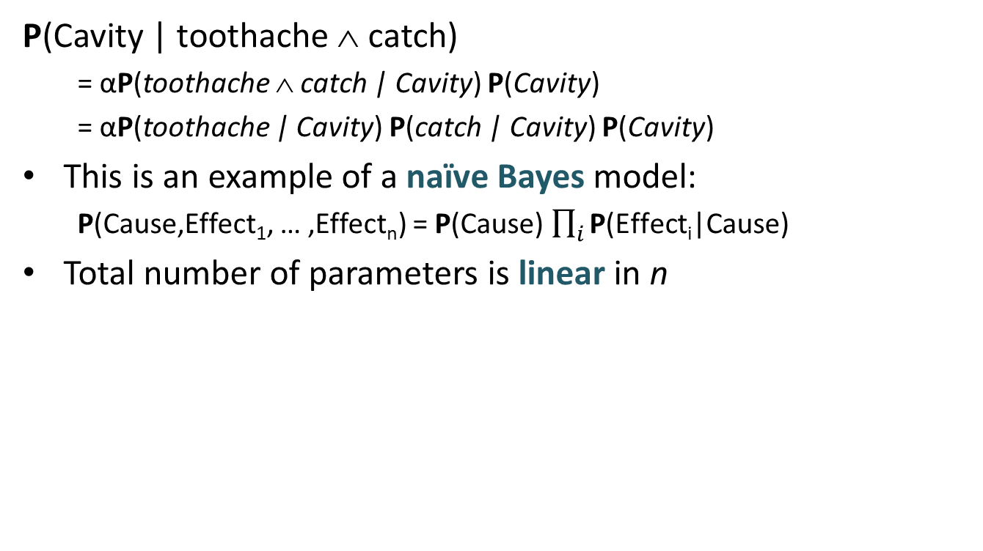
Bayes’ Rule and Conditional Independence
P(Cavity | toothache ∧ catch)
= αP(toothache ∧ catch | Cavity) P(Cavity)
= αP(toothache | Cavity) P(catch | Cavity) P(Cavity)
This is an example of a naïve Bayes model:
P(Cause,Effect₁, … ,Effect_{n}) = P(Cause) $\prod_{i}{\text{P}\text{(}\text{Effect}\text{i}\text{|}\text{Cause}\text{)}}$
Total number of parameters is linear in n

Slide 36
Summary
Probability is a rigorous formalism for uncertain knowledge
Joint probability distribution specifies probability of every sample point (atomic event)
Queries can be answered by summing over atomic events
For nontrivial domains, we must find a way to reduce the joint size
Notes:
Rigorous→kesin, kati

Slide 37
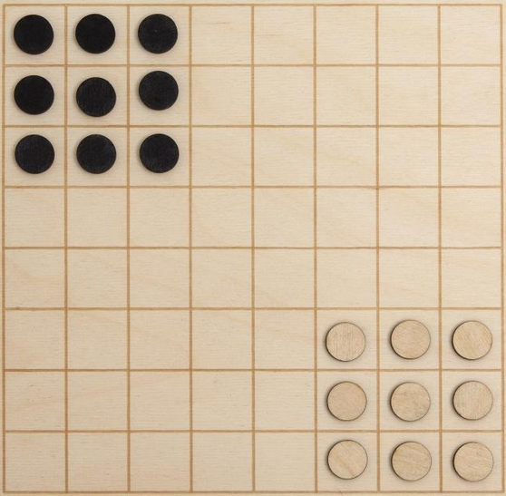
Homework II
Klasik Çin daması oyununu mini-max algoritması ile oynayan bir ajan geliştiriniz.
Ajan çeşitliliği arttırmak için benzer değerli hareketlerden herhangi birini yapmayı rasgele tercih edebilir.
Çin daması oyununun kuralları:
İki oyuncuyla klasik dama tahtasında oynanır.
Rakip oyuncuların herbirinin siyah veya beyaz renkli 9’ar taşı bulunur.
Rakip oyuncuların taşları kendilerine göre sol üstteki 3x3’lük karelerde yer alır.
Her oyuncu kendilerine göre sağ alttaki 3x3’lük karelerde yer alan taşları hareket ettirebilir.
Taşlar her seferinde bir kare ilerleyecek şekilde ileri ve yan hareket edebilir.
Taşlar çapraz hareket edemez ama tekrarlı hareketlerle öncekine nazaran çapraz bir konuma yerleşebilir.
Sadece rakibin taşlarının bulunduğu sahaya geldiğinde geri hareket edebilir.
Rakip taşlar birbirlerini almaz.
Oyun sonunda her iki tarafın da yine 9 taşı vardır.
Taşlar birbirlerinin üzerinden atlayabilir.
Taşlar hem oyuncuların kendi taşları hem de rakip oyuncunun taşları üzerinden ileri ve yan hareketlerle atlayabilir.
Taşlar her atlamadan sonra kendisi için yeni bir boşluk bulduğu sürece atlayabilir.
Oyuncuların ana stratejisi taşların oluşturduğu bu merdivenleri kullanarak hızlandırılmış hareketler gerçekleştirmektir.
Fakat aynı zamanda bu merdivenler rakip oyuncular için de önlenmelidir.
Bu oyundaki amaç, oyuncuların kendi taşılarını sağ alt köşeden rakip oyuncunun köşesine ilk düzende olduğu gibi taşımasıdır.
Aynı renkli taşların herhangi bir ayrımı olmadığından hedefteki 3x3’lük alana taşındığı sürece taşın hangi konuma yerleştiğinin bir önemi yoktur.
Buna göre ilk hedefe varan oyuncu oyunu kazanmış olur.

Slide 38
Homework II (Devam)
Hazırlayacağınız ödev raporunda,
Çin daması oynayan ajan için mini-max algoritması ve alfa-beta budaması tekniklerini kullanarak ajanı nasıl tasarladığınızdan kısaca bahsediniz.
Problemin çözümü için kodladığınız durum, hareket, algı, hedef fonksiyonu, ardıl fonksiyonu ve sezgi fonksiyonu tanımlamalarını yapınız.
Hareket tanımlarının ve ardıl fonksiyonunun taşların birbiri üzerinden atlayarak yapabileceği tüm olası hareketler için düzenlenmesini sağlayınız.
Mini-max algoritması ile farklı katlarda (2-kat, 3-kat, …) ileriye bakabilen iki ajan tasarlayınız.
Ajanlar birbirlerine karşı 5 kez oynatıldığında hangi ajanın hangi skorla kazanmış olduğunu belirleyiniz.
Bir oyunun tamamlanması için geçen ortalama süreyi belirleyiniz.
Her ajanın bir hamle gerçekleştirilmeden evvel harcadığı ortalama süreyi belirleyiniz.
Mini-max algoritmasına alfa-beta budaması dahil edildiğinde belirlenen ortalama sürelerde bir değişme olup olmadığını açıklayınız.
Yazdığınız kodu IDE’de göründüğü kalitede kopyalayınız.
Ekran çıktısındansa aynı font tipinde ve düşük font boyutunda kopyala yapıştır ile.
Ajanların birbirlerine karşı oynadığı oyunlardaki farklı tahta durumlarında yaptığı hamlelere dair konsol veya grafik arayüz ekran çıktısını ekleyiniz.

